Slide 1
Review of Week 1

Slide 2
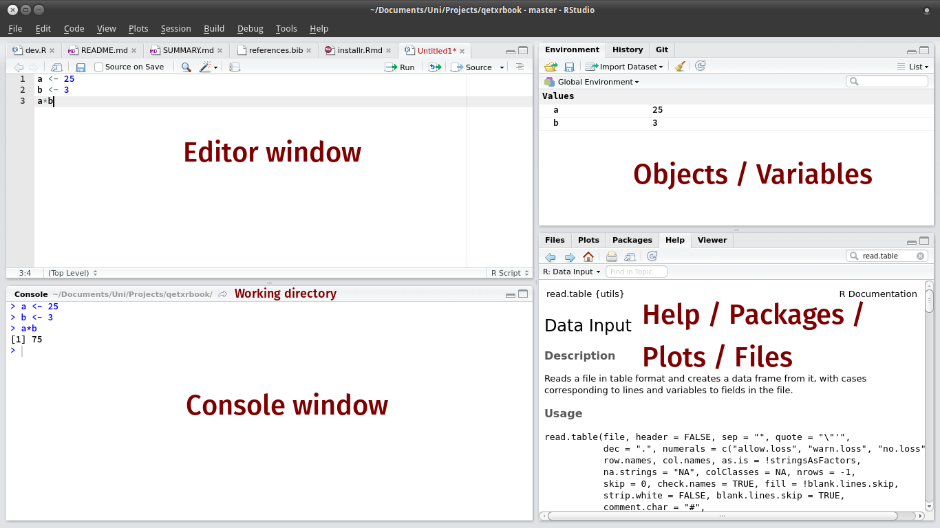
The RStudio Interface

Slide 3
Data structures
Vectors (single column/row of data, one type)
Matrices (two dimensional array of data, one type)
Data frames (two dimensional array of data, many types)
Lists (most flexible, can hold anything)

Slide 4
Types of data
Numeric: Numbers
Character: Strings
Logical: TRUE/FALSE
Factor (today): Categorical data

Slide 5
Functions
Functions generally do things to objects (the data structures we just reviewed)
Functions take arguments that modify how they work
Arguments have names, are ordered, and often have default values

Slide 6
Functions we learned
mean
median
sd
class
min
max
which.min
which.max
sqrt
log
head
tail
summary
str
c
rep

Slide 7
Logical tests
You can use logic in R to test whether things are TRUE or FALSE
For example:
2 > 4
10 != 11
10 == 10
sum(c(3, 4, 5)) >= 14

Slide 8
Subsetting
You can refer to specific parts of an object using subsetting
e.g.
a <- rep(1:3, each = 3)
a[c(3, 7)]

Slide 9
Logical subsetting
We can use the results of logic tests as an input to subsetting
This retrieves only the parts of an object that correspond to a TRUE value
a[a > 2]

Slide 10
Subsetting data frames
Subsetting on data frames requires two pieces of information, since they have two dimensions
We use square brackets, but now have a comma to separate row indices from column indices
pets <- data.frame(‘animals’ = c(‘cat’, ‘cat’, ‘dog’), ‘owners’ = c(‘Pete’, ‘Steve’, ‘Alice’))
pets[1, 2]; pets[1,]; pets[, ‘animals’]

